Slide 1

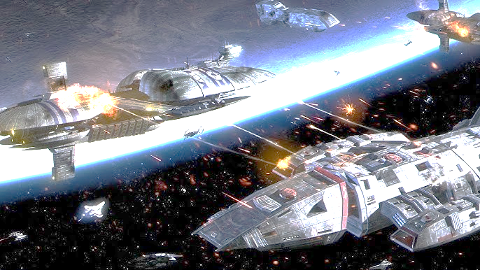


Slide 2

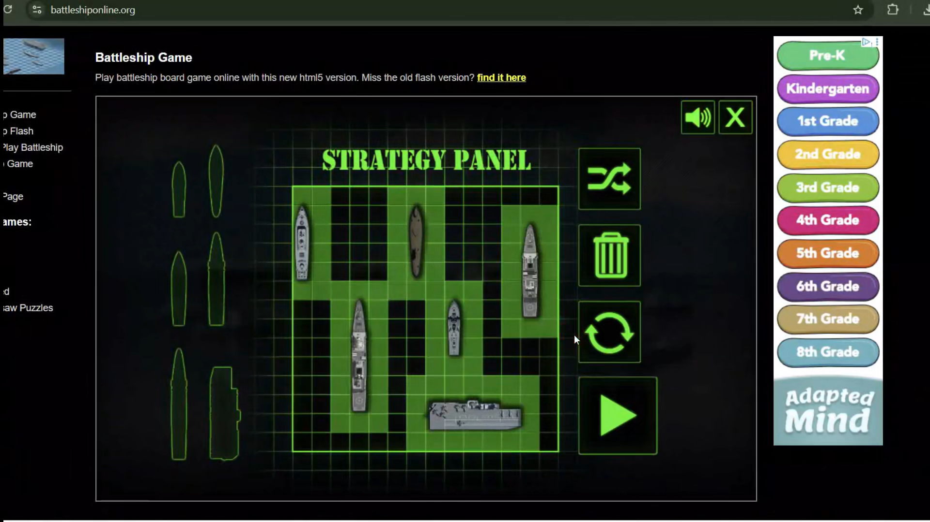
Classical Battleship
Each player places battleships on their grid.
Player 1 fires by selecting a square on Player 2’s grid.
The attacked square is marked and turns red if a ship is hit.
Player 2 takes a turn and follows the same procedure.
The game ends when one player’s entire fleet is sunk.
https://www.battleshiponline.org/

Slide 3
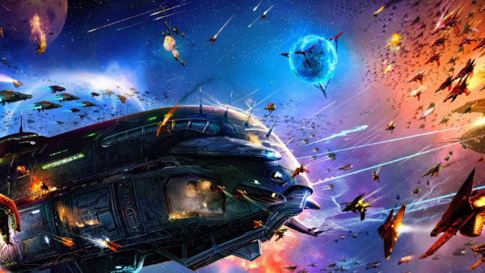
QStrike!
Attacker can send a superposition of 2 attacks on defender's grid with different arbitrary phases.
Defender can attempt to defend any one position via destructive interference of the phases and attack another, or attack 2 positions.
A measurement is done to determine which attack lands.
On the next turn, the attacking and defending roles switch.
Notes:
Introducing! QStrike!
As technology improves, new weapons emerge as humans take to the stars
Quantum weapons elevate gameplay! Shoot your enemies starships out of space
Player 1 can send a superposition of 2 attacks with different phases
Player 2 can either defend one position via destructive interference and attack another, there's a twist! Player 2 doesn't know the phase of attack it's defending against, only the quadrant it's in. It can only full remove the possibility of a strike if they guess the phase properly
If player 2 doesn't want to defend, they can launch a superposition of 2 attacks on player 1's grid

Slide 4
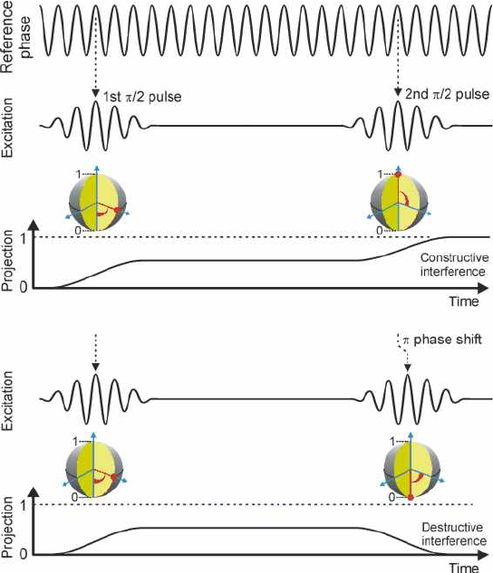
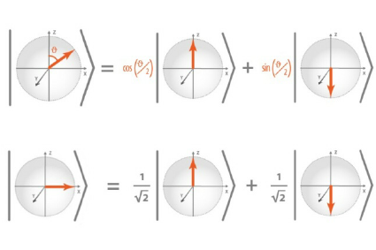
QStrike: Let’s Go Quantum
Quantum Superposition
Quantum Phase and Interference
Measurement
Krenner, Hubert st. al.(2005). New Journal of Physics. 7. 10.1088/1367-2630/7/1/184.
Dür, W. & Heusler, Stefan. (2013). What we can learn about quantum physics from a single qubit.

Slide 5
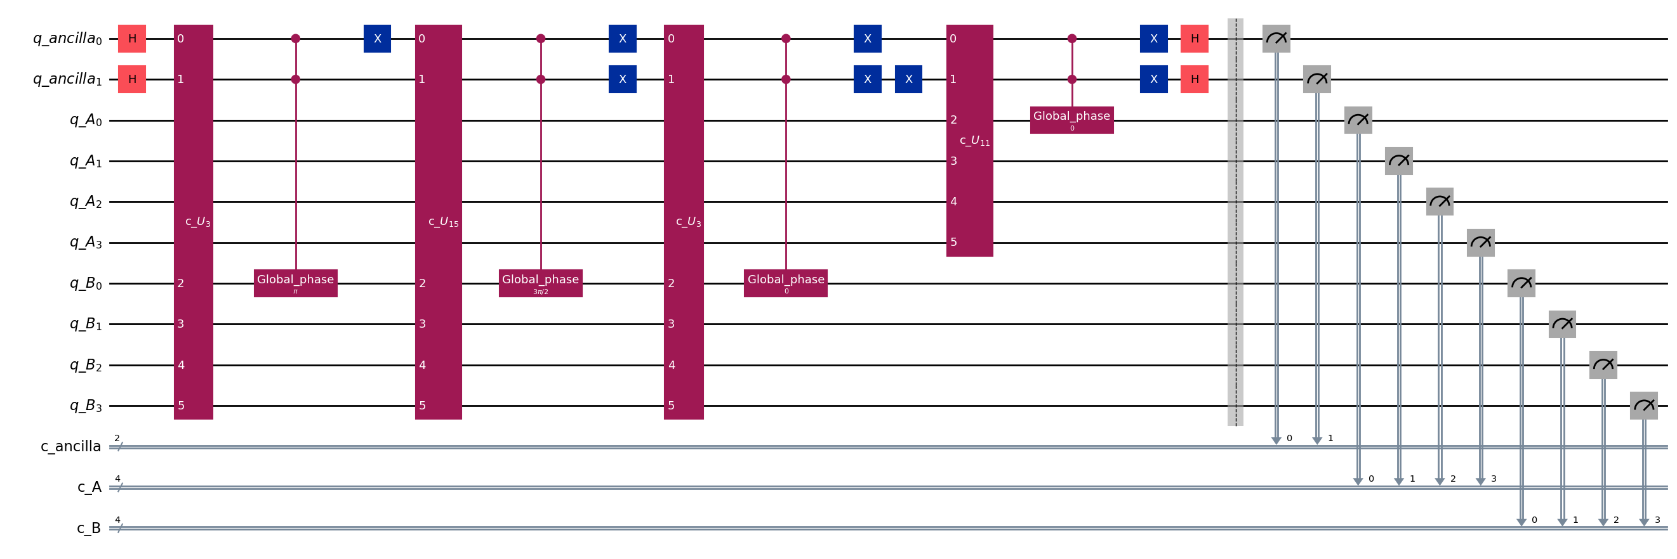
Quantum Mechanics on Fire
QStrike Quantum Circuit based on linear combination of unitary circuits

Slide 6
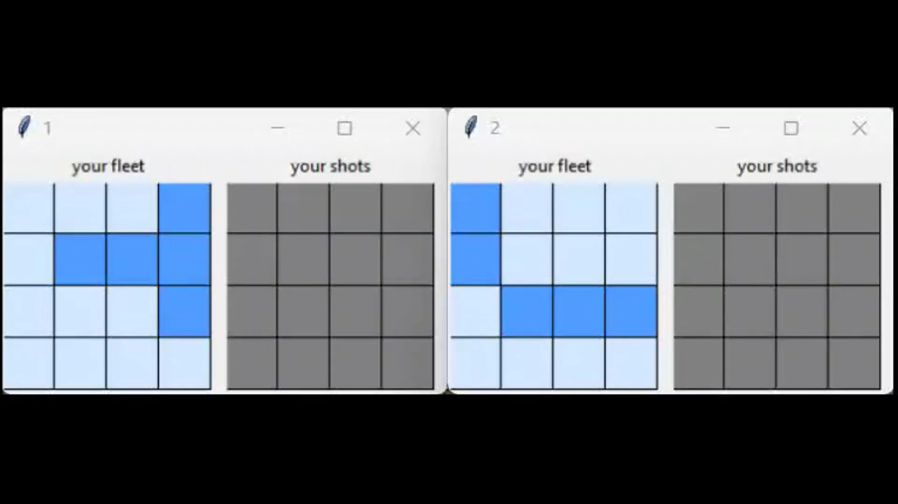
QStrike in Action
Spaceships
Spaceship hit!
Selected shots!
Defence is on!
Missed shot!

Slide 7
Destroy your enemies with QStrike!

Slide 8
